Slide 1


Role of AI in Safety and Security in CPS and IoT systems
Shameek Bhattacharjee
Department of Computer Science
Western Michigan University, Kalamazoo, MI
This lecture slide deck is part of outreach activity for National Science Foundation Education Grant 2017289

Slide 2
Main Agenda
“ The Good and Bad of using AI for Cybersecurity especially for CPS/IoT Networks and Systems ?
Why we need to do now → a result of limitations with older cybersecurity practices in emerging
Birds Eye View of Cybersecurity as a science (as opposed to technology)
Need for of AI in IoT/CPS security
Algorithmic Vulnerabilities and Pitfalls of using AI for security
(next submodule)

Slide 3

Traditional Cyber Attack Classification (CIA) triad
Integrity
Ensure information is not modified, falsified and manipulated.
(preserve accuracy of data)
Availability
Ensure information is readily available to authorized entities. E.g.
(timely access & use of data)
E.g. Data Falsification, Byzantine Attacks, Spoofing, False Reporting
E.g. Denial of Service, Jamming Attacks, Data Omission, Failure
Additions to Triad
Authentication
Authorization and Access Control
Non-Repudiation
Confidentiality
Ensure information is not disclosed to unauthorized entities. E.g.
( restrict visibility of data )
E.g. Phishing,
Keylogging, Wiretapping, Sniffing

Slide 4
Six Cornerstones of Cybersecurity Science and role of AI

Slide 5
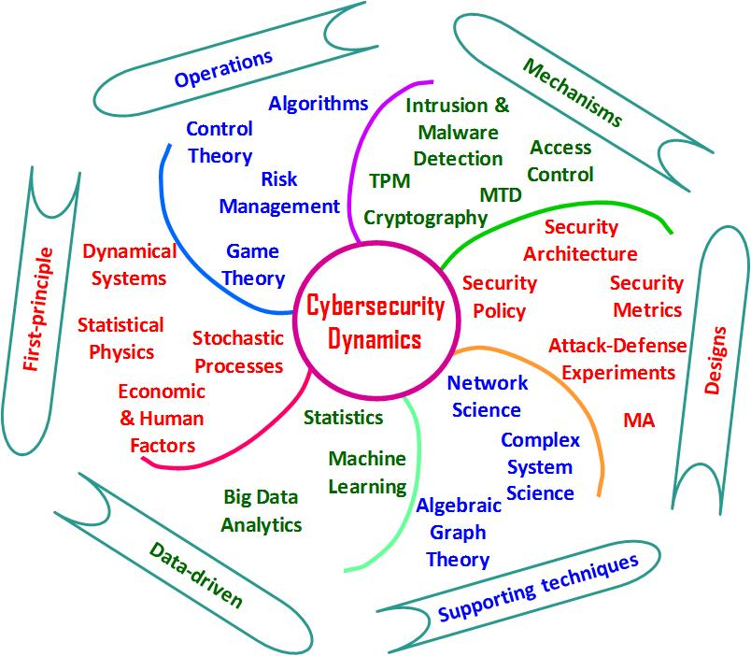
Fig by: Prof. Shohaui Xu
Coined in 2008 by NSF/IARPA/NSA
Decision
Current Security Mechanisms
→ Science of 1970-90’s
Cyber-Physical-Social Systems have evolved
Cannot view Cybersecurity as only technology or engineering
“A NEW Science” for evolved systems of today.
AI has evolved
AI based SECURITY

Slide 6
Why data integrity and availability in IoT/CPS is challenging
Lack of Crypto-agility (due to design limitation)
Real Time Constraints on operations
Transduction Attacks / Physical Exploits
Manipulation of Sensory Environment
Insider Compromises

Slide 7
Lack of Crypto-agility
Secrecy of RSA algorithm (most commonly used for public key cryptography method) depends on the inability of an adversary to calculate/guess “those two randomly-chosen large prime numbers used to derive the RSA's algorithms' public key”
One must ensure that the random primes for public key creation are as random as possible.
Random number generators (RNGs) use physical non-deterministic `inputs’ (e.g. timing clock, chip imperfections, keystroke patterns, mouse moves) in the form of measurements drawn from the computer system to generate this randomness.
However, IoT devices have limited hardware; hence the availability of non-deterministic inputs is limited. Thus randomness in the primes are reduced; encryption is easier to break
Once encryption is broken, the data can be falsified easily that affects AI/Ml algorithms and IoT operations

Slide 8
Real Time Constraints
Many industrial IoT/CPS have strong to real time requirements
Adding strong encryption slows down the data generation and data transmission process
This because encryption takes time and resources and increases the effective data size
Hence, some IoT/CPS systems lack authentication and encryption altogether
IoT/CPS units are not suited for frequent updates and patching unlike traditional cyber world.

Slide 9
Transduction Attacks on IoT/CPS devices
Transduction attacks exploit unintended functions of circuitry to threaten the integrity and availability of sensor output.
How? Let us understand working of a sensor in a field device CPS
Sensors translate physical quantities in analog to electrical signals (binary representation)
Example: drone software uses the abstraction of a signed integer to represent the output of a gyroscope for flight stability and altitude control
The firmware of IoT device or remote API software records the digital output, not the physical analog signal

Slide 10
Transduction Attacks contd..
Manipulate a sensor circuit with “external stimuli” →
prevents accurate translation of analog to digital data output → data is falsified
Extent of data change can be controlled by the signal strength of the external stimuli
External Stimuli Types include
Opportunistic attacks: requiring no special-purpose equipment
Advanced attacks: that require special-purpose transmitters and basic understanding of physics
Check: [1] Trippel, T. et al. WALNUT: Waging doubt on the integrity of MEMS accelerometers with acoustic injection attacks Euro S&P, 2017
[2] K . Fu, et. al. “Risks of trusting physics of sensors” , Communications of ACM, 2018

Slide 11
Examples of External Stimuli
Acoustic attacks: Long-Range Acoustic Device (LRAD) to deliver intense sound waves from a mile away onto IoT devices
Infrared rays
Sonic Beams
Laser Probes
All of the above can induce wrong data being recorded at the field area sensors.

Slide 12
Sensory Environment Manipulation
This attack does not directly affect the IoT or field area device function
Cause disturbances such as interference and noise in the immediate analog RF environment near the field area device or IoT device.
Such disturbances causes incorrect data to be sensed and recorded.
Zhang, G. et al. DolphinAttack: Inaudible voice commands, ACM CCS, 2017

Slide 13
Summary of Challenges in IoT security
Domain Specific Issues
IoT Device Characteristics:
Limitation on computation power, memory, etc.
Limitation on updating and patching.
Strong on-device security controls cannot be deployed
Additional IoT/CPS challenges:
Large number of device types and manufacturers, various kinds of vulnerabilities and attack types
Each IoT domain would require many defense models
We need defense mechanisms that generalize

Slide 14
Summary of Approaches in IoT Security
Category Issues
1. Network-level data flow, deep packet high overhead
2. Device-specific profiling/fingerprinting do not scale → heterogeneity of IoT device types
3. Attack specific needs separate solutions for each cyber attack.
4. Network segmentation mitigate the movement of attacks, but do not detect
5. Localization approaches do not detect attacks on already authenticated devices.
6. Embedded security architecture expensive and impractical to scale due to heterogeneity
7. Adopt known ML/AI techniques ? see next page
Notes:
SoK: Fingerprint device component to provide consumer report evaluation for each IoT device [8]. → device specific
IoT device profiling [4] → device specific​, point solution
Dolphin Attack, Inaudible Voice Commands and Skill Squatting on Amazon Alexa [6,7] ​ → Attack specific
Network Segmentation, VPN → passive mitigation

Slide 15
Why AI and ML for CPS security ?

Slide 16
Why ML/AI approaches for CPS/IoT Security
Reasons to use ML and AI for Security
Attack Detection is a classification problem (just like in typical ML)
Hence, it makes sense to build new ML models or apply known models to attack detection
If learning model is robust, it could also aid in mitigation of attacks
Anomaly Detection is critical against smart and stealthy attacks which is typically viewed as a unsupervised learning problem (where traditional approaches fail)
A unified approach of science is possible that works across various application domains and heterogeneous device types → a feature of CPS and IoT systems
AI
ML

Slide 17
Understanding Different AI Approaches
Symbolic AI
Natural Language Processing
Expert Systems
Knowledge Representation
Predicate Logic
Robotics
Sub-Symbolic AI
Perceptron Neural Networks
Evolutionary Computation
Fuzzy Logic
Computational Neuroscience
And cybernetics.
Statistical AI
Machine Learning
Deep Neural Networks
Information Theory
Bayesian Learning
Markov Models
Disadvantage: Does not generalize well
Advantage: More explainable due to semantic understanding and hand-crafted features
Advantage: generalize well across applications
Disadvantage: Deep learning not explainable hence performance guarantees in security and safety especially difficult
Notes:
Old fashioned
Uses hand-crafted knowledge

Slide 18
Industrial IoT and CPS
Primary BUS
→IP based traffic
Secondary BUS
→ Non- IP based traffic
Simple hardwired cables with voltage and current control
serial links
Config can vary

Slide 19
Unique issues in CPS safety and security
Addressing the cyber and physical element in the safety and reliability of CPSs is of utmost importance.
CPS security is ultimately about safeguarding the process variables and not the network traffic (since those are studied in traditional cybersecurity anyway)
IoT and field area devices offer limited protection from traditional cyber security threats which can allow control of field area devices.
Data and process-oriented designs for monitoring and intrusion detection is of importance → AI and ML can help therefore
All of the process variables cannot be monitored in community scale.

Slide 20
Unique issues in CPS safety and security
Critical process variables need to be monitored for alerting → dimensionality reduction
Learn critical values and normal ranges of those critical values is difficult if only network traffic data is used. Hence data driven understanding of CPS/IoT processes are important.
Collaborative approach to constructing the security model → needs intelligent fusion (branch of AI)
(1) plant operator input,
(2) sensor data
(3) data from network layer.
IDS alerting by the Sensor Node is generated from anomalies on the process layer by monitoring critical process values.

Slide 21
More Challenges with AI and ML approaches
Many applied ML papers that exist are steady state detectors (they use the whole attack dataset to find the attack at the end of test set)
Most ML approaches in IoT security not explainable. We need lower bound performance guarantees.
For IoT provider what is important ?
Which IoT devices are under attack on your network?
Can give user an indication on which devices/services to disable?
Timely identification of attacks

Slide 22
Pitfalls of using ML/AI for IoT/CPS security
ML and AI methods `themselves’ are vulnerable to a separate class of attacks “adversarial attacks”
The term adversarial means → anatomy of these attacks are designed according to a strategy
whose objective is to “exploit” the internal working philosophy of a learning model in question.
Most often the adversary’s optimization objective is opposite of what is intended by the learning model
Popular ML and AI techniques share design similarities e.g. minimizing a loss function, using similar loss functions across techniques.
Therefore, an adversarial designed for one ML technique also shows success against other ML techniques (transferability of adversarial examples against ML and AI methods)
Conclusion
It will be unsurprising that ML/AI approaches built for security will themselves be vulnerable.
We cannot solve for one set of attacks only to make it vulnerable to another set of attacks

Slide 23
Few of Common Pitfalls in Threat Modeling
The threat model is often not representative of real adversarial behavior
Adversaries have the element of surprise; strategize through the realm of gains and not losses (unlike defenders)
Adversaries do not want to get caught easily and takes precautions before hand
Most adversaries possess prior knowledge about system and usual defense mechanisms (Kirchoff’s principle).
Hence, security by obscurity does not work and solutions need to account for this.
Defenses are often tailored for particular attacks (AI and ML methods can help)
Problems with Metrics for Validation of how much secure your system
Dependence on Machine Learning and AI (makes them vulnerable to adversarial attacks)

Slide 24
AI based Security should be ideally Bi-Directional
Three simultaneous approaches emerged at the intersection of artificial intelligence (AI) and cyber security.
AI approaches that augment traditional security solutions to detect/protect from cyber attacks;
Research on physical exploits (physics based cyber attacks) affecting cyber infrastructure
Research on adversarial attacks exposing vulnerabilities of AI or machine learning;
“Ideally, a foundational framework with a bi-directional approach is essential; one which
uses secure by design AI approaches for cyber security. “

Slide 25
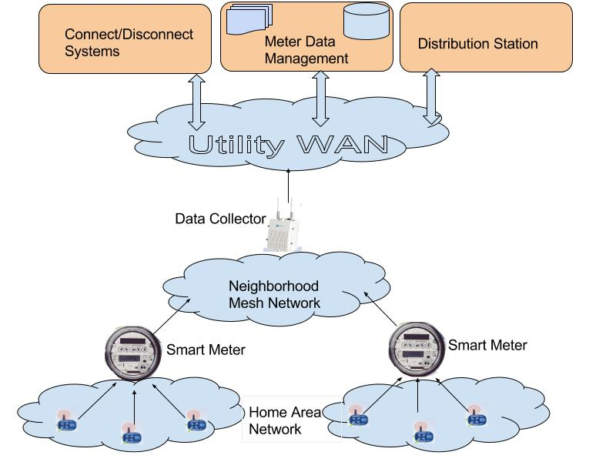



Smart Metering Infrastructure: An IoT Domain
Insider Threat
Advanced Persistent Threats
Data Falsification
Nan Gateway
Demand Response / Pricing Signals
Physical
Consumption
Data Send Periodically
Cyber
Smart Appliances
Plug-in Vehicles
Notes:
Crypto, NIDS, HIDS not enough

Slide 26



Smart Grid: Large scale CPS
Cascade Failures, Line overloads, Bus failures
Transmission Layer
Centralized
Intrusion Detectors
Privacy Leakage
Insider Threats
WAMS Utility WAN
Distribution Layer
Data Center Control Tier
Trustworthy
Computing
Man in Middle, Omission
PDC
DSO
PMU False State/Data injection
Substation
Control Tier
PMU
PMU
Distribution Substations
Cascade Failures
Man in Middle, Omission, Physical Attacks
Customer Layer
Distributed Intrusion Detectors
NaN Gateway
Aggregator
Neighborhood/Field Area Network (NaN/ FaN)
Deductive, Additive, Camouflage ,Conflict, Load Altering
(Static/Dynamic)
Pricing Attacks
Pricing Attacks
Embedded Intrusion
Detectors
Residential
Commercial
DER Micro
grids
PEV Network
Home Area Networks (HAN)

Slide 27
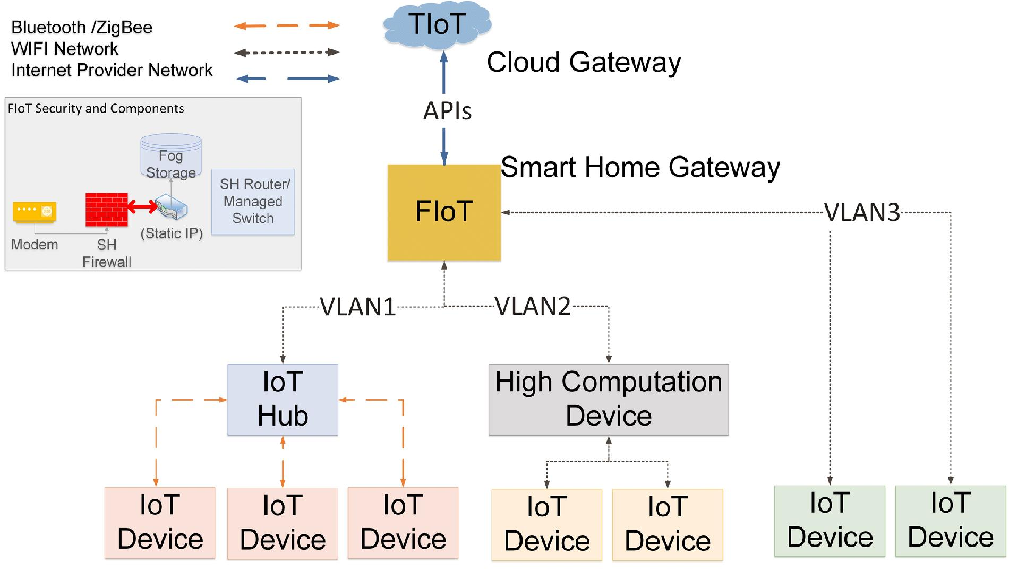
Smart Home IoT
Global Controller
(cloud)
Specification
Compliant attacks
are better detected with AI
Local Controller
(fog)
(e.g. Amazon Echo Dot)
(e.g. smartphone)
Edge Aggregation
(edge)
Uses firmware
IoT Device
Sensing/Actuation
Notes:
Three ways an IoT device could offer services →
How does it offer services → through an API → API could be on-device , on external high computation device (like a mobile), or installed on an IoT Hub device (like Amazon Echo Dot) that offers Alexa services.
IoT service providers host their services on local or remote/cloud servers on the internet.
APIs help to connect to those servers hosting services and offer them via the IoT device (VIA the FOG NODE)
Thus, there is a mapping between an IoT services and servers that host such services.

Slide 28


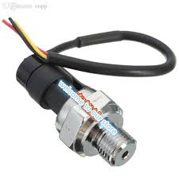

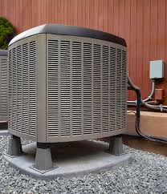

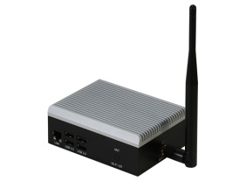

Smart Connected Communities as CPS
Decision & Control
Traffic
Estimation
Wide Area Estimation
Reroute or not
Open/ Close→ Valve & Pumping Stations
Water
FAN Gateway
Analytics
Reroute Signals
Switching Signals
Unified Security
RoadSide Units
Water Meters
IoT Devices
Smart Pipes, Valves
Junctions
Physical
World
Smart
Vehicles
Smart Energy
Smart Transportation
Smart Water Network
Notes:
Crypto, NIDS, HIDS not enough

Slide 29
Aspects capturing data integrity attack landscape
1. Attack Surface: different points where attacks could originate
2. Attack Types: The way adversary change data → from a single data source or multiple data source → depends on intended nature of impact
3. Attack Strength: the extent of data alteration on average (alteration capability)
4. Attack Scale: the fraction of data points compromised to launch false attacks (insertion capability)
5. Attack Strategic Distribution: how the attack is implemented based on adversary’s prior knowledge (knowledge capability) → after module
6.Attack Impact: quantifiable impact as function of changing attack strength, scale, type
7. Attack Stage: Training or Testing phase (Very Important in Near Future Times)

Slide 30

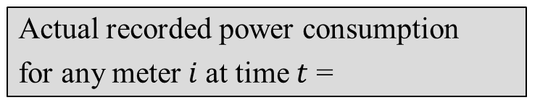



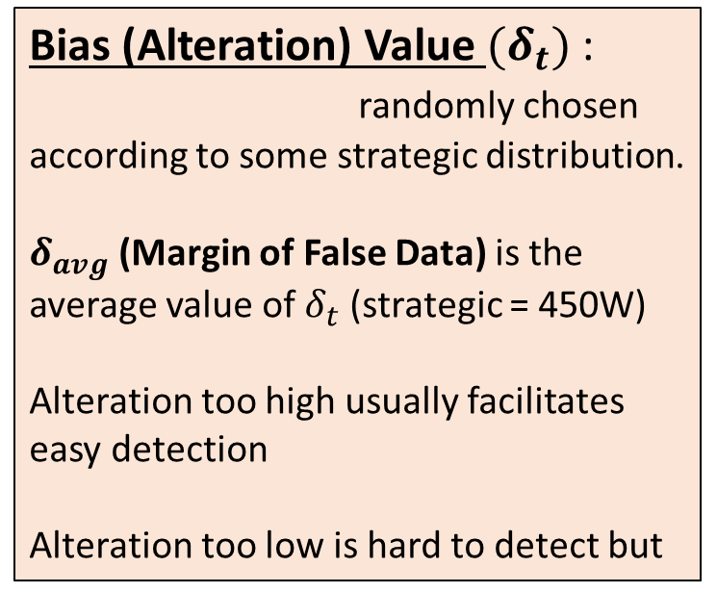
Data Falsification Attack Types
Actual recorded power consumption
for any meter $i$at time $t$ =
Bias (Alteration) Value ${(δ}_{t})$:
randomly chosen according to some strategic distribution.
$δ_{avg}$ (Margin of False Data) is the average value of $δ_{t}$ (strategic = 450W)
Alteration too high usually facilitates easy detection
Alteration too low is hard to detect but
$${P^{i}}_{t}\left(act\right)$$
$$δ_{t} ∈\{δ_{min} , δ_{max}\}$$
Data Falsification Attack Types:
Additive →
Deductive→
Camouflage: Balanced additive &
deductive attacks.
Conflict: Unbalanced additive
and deductive attacks.
Alternating Switching: Oscillate between additive and deductive over time domain
Replay: sends old data that masks a special event of emergency
${{P^{i}}_{t}{= P}^{i}}_{t}\left(act\right)$ + $δ_{t}$
${{P^{i}}_{t}{= P}^{i}}_{t}\left(act\right)$ - $δ_{t}$

Slide 31
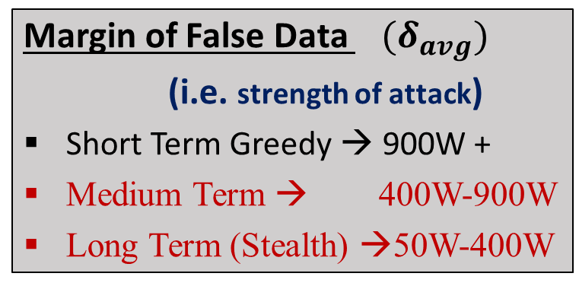
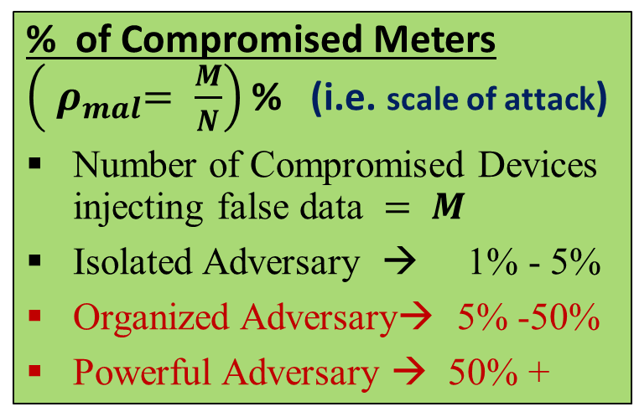
Attack Strength and Scale
Alteration Capability
Insertion Capability
Margin of False Data ${ (δ}_{avg})$
(i.e. strength of attack)
Short Term Greedy → 900W +
Medium Term → 400W-900W
Long Term (Stealth) →50W-400W
% of Compromised Meters $\left({ ρ}_{mal}= \frac{M}{N}\right)$ % (i.e. scale of attack)
Number of Compromised Devices injecting false data $= M$
Isolated Adversary → 1% - 5%
Organized Adversary→ 5% -50%
Powerful Adversary → 50% +
Factors dictating them:
(a) Scale → attack budget/cheapness of exploit/ the size N of data points
(b) Strength → target time to recover attack cost, level of stealth, target time for impact
Pitfalls:
1. Not parameterizing as variables
2. Underestimate Attack Scale by connecting it to only attack budget
3. Arbitrary margins
Examples are given in the assigned readings and later lecture

Slide 32
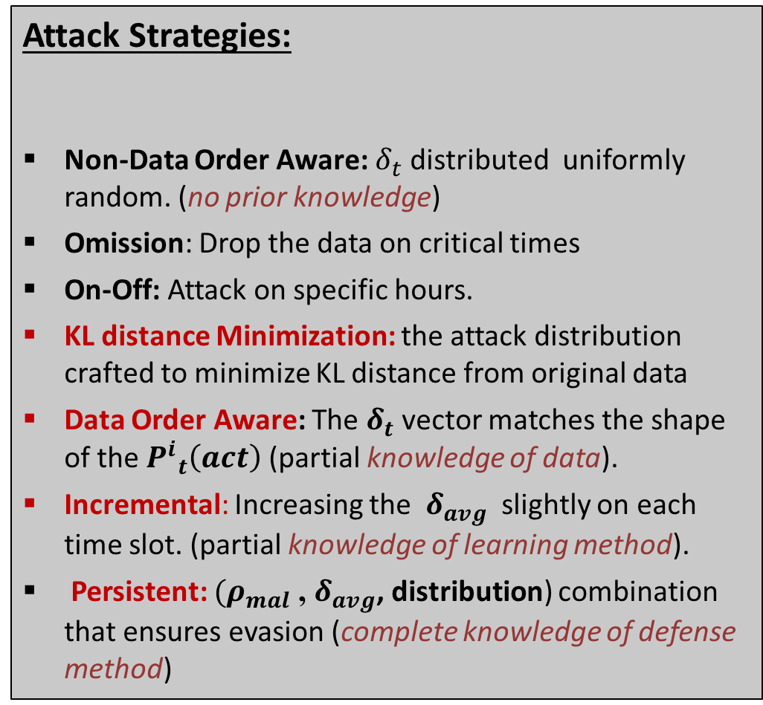
Attack Distribution Strategy
Attack Strategies:
Non-Data Order Aware: $δ_{t}$ distributed uniformly random. (no prior knowledge)
Omission: Drop the data on critical times
On-Off: Attack on specific hours.
KL distance Minimization: the attack distribution crafted to minimize KL distance from original data
Data Order Aware: The $δ_{t}$vector matches the shape of the ${P^{i}}_{t}\left(act\right)$ (partial knowledge of data).
Incremental: Increasing the${ δ}_{avg}$ slightly on each time slot. (partial knowledge of learning method).
Persistent: ${(ρ}_{mal}$ , $δ_{avg}$, distribution) combination that ensures evasion (complete knowledge of defense method)
Explore the full attack strategy space
Prior Knowledge Level
Pitfalls:
Not taking attacker knowledge of
Various levels into account.
2. Not taking into account the fact that defense mechanism may be completely known to the adversary (why is this reasonable? ).

Slide 33


Crowd Sensing as CPS domain
False Reports and Ratings
Event
Published
Reports
(Contributions)
Crowd
Sensing
Server
Feedback Monitoring
Consumers
Event Analytics
And Decision
Crowd Sensing (CS)
Report: Citizens contribute data, alert, notification.
3 aspects of Crowd-Sensing
(Published) Event: A consensus status inferred from the reports, e.g. jam, accident, road closure, weather hazard.
Feedback Monitoring: Endorsement on the published event
Viz. Ratings, e.g. Useful, Not useful, Not sure, 5 star ratings
Notes:
No ground truth is known, Feedback Monitoring is done by an Anomaly Detector or Humans themselves who are not reporters
Event true or false
User Trusted or not
Future event publish or not…based on priors..

Slide 34
Typical Workflow in Participatory CS
During the training or cold start phase
- the crowdsensing platform depends on feedbacks by the crowd over the contributions supplied by reporting users
- Feedbacks used to learn about reputation level of users
- crowd platform does expensive ground-truth collection to find prior likelihood of events in a given context
During deployment and testing
user reputation, context likelihood of event, report
patterns combined in event publishing decisions

Slide 35
Threat Landscape in Crowd-Sensing
Exploits→ Use Hardware Emulators
Hack Mobile Apps, Fake-Loc. Apps
Why Selfish Intent ? (undue incentives)
Incentive mechanisms to motivate constant reports from users.
Incentivize based on degree of contribution (quantity) rather than quality of contributions.
(Huge # of false reports [Bhattacharjee et. al., IEEE CNS ’17] in Google Waze Dataset)
Feedback Weaponizing Attacks:
(happens during training)
Ballot stuffing: Rogue raters give positive ratings to false events.
Bad mouthing: Rogue raters give false ratings to true events.
Obfuscation stuffing: Rogue raters give uncertain ratings to false events
Why Malicious Intent ?
Create congestion (civilian)
Drain company’s revenue (economic)
Strategic blocks or voids (internal security)
(Sinai et. al. DEFCON 14, News Reports LA)
Belief Manipulation Attacks:
(happens during deployment)
Orchestrate a fake event in a location with high prior likelihood with increased chance.
Choose to suppress true events in a location low prior likelihood, with bad mouthing.
(exploiting the use of priors in decision making)
Reporting Behaviors:
Honest: mostly reports true events.
Selfish: intermittently generate true and false events. (2 groups)
Malicious: frequently collude on reporting the same false event type.
Notes:
.

